Slide 1
Announcements
I will be taking up your artist journals to grade on Wednesday, October 1st
^{Estoy ocupando los} diarios de artista para calificare miercoles, el primero de octobre
You should make sure you have
1. Definition (La definición)
2. Writing Responses (Repuesta por escrito)
3. Drawings/ doodles (dibujos)
In EACH section
Hint: it is easiest to do all of this in class

Slide 2
Please retrieve your portfolios and have signature ready
We will:
I will:
Explore Balance and Emphasis, two important Principles of Design
Continue our Zentangle project
Answer a mini-quiz in my artist journal concerning the types of Balance and creating Emphasis in an artwork
Complete my entire matrix of Zentangles using 12 different tangles

Slide 3
Balance &
EMPHASIS
Principles of Art
Balanza y énfasis
Principios del arte

Slide 4
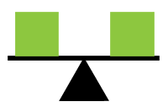
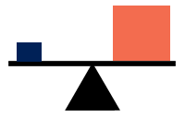
Balance La Balanza
3 Types:
Symmetrical, Asymmetrical, Radial
Simétrico, asimétrico, y radial
How the elements of art are arranged in an artwork
What gives a design stability
Helps keep a design distributed evenly and keeps it from being lopsided
Gives a sense of flow
Cómo los elementos se arreglan en una obra de arte.
Lo que da una estabilidad del diseno.

Slide 5
Symmetrical Balance
A mirror image
If a picture has symmetry you could draw a line down the middle and both sides would be the same or similar
This type of balance is often seen in architecture
Equilibrio simétrico
Una imagen de espejo
Si dibuja una linea por el centro ambos lados son iguales
http://www.deviantart.com/morelikethis/59388178

Slide 6
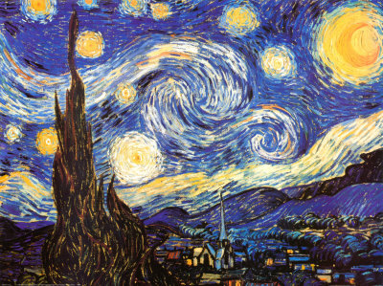
Asymmetrical Balance
Several small items on one side of a picture balanced by a larger item on the other side
Can also be made using color
– bright vivid colors are balanced by neutral colors
Balanza Asimétrica:
Un objecto grande equilibrado por varios pequeños objetos
Colores brillantes son equilibrados por colores neutros
https://moodymiddle.wikispaces.com/Josh

Slide 7
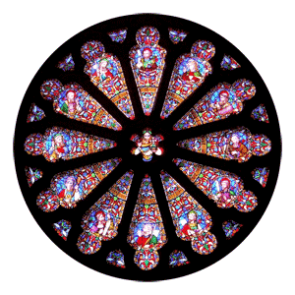
Radial Balance
All objects in a design radiate from a central point
Balanza Radial
Todos los objetos irradian desde un punto central
http://skpgfinearts.com/Balance.html

Slide 8
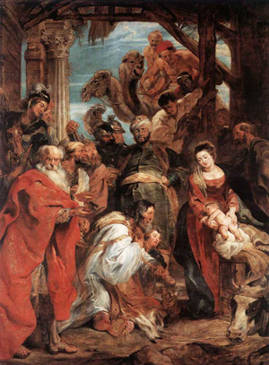
Write about it:
How do the colors create balance in this painting?
¿Cómo los colores crear equilibrio en esta pintura?
Answer: In Rubens’ Adoration of the Magi, the composition is balanced around the central figure by the lighter figures in the bottom left and the darker areas in the upper right.
En “La adoració de los magos” de Ruben, la composición tiene balanza de la figura central de las figuras más ligeras en la parte inferior a la izquierda y las áreas más oscuras en la parte superior a la derecha.
Peter Paul Rubens. Adoration of the Magi. 1624. Oil on panel.
http://skpgfinearts.com/Balance.html#sthash.4FsH9ohM.dpuf

Slide 9
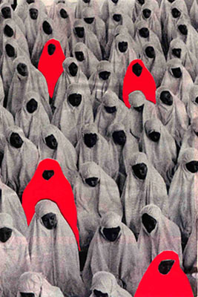
Mini-quiz: 3 answers
Pequeño cuestionario: 3 repuestas
1. Name the type of balance
Llame el tipo de balanza
Robin Colomb
http://www.peonqueen.com/ArtSpace/temp_exhib/art2/bal.html

Slide 10
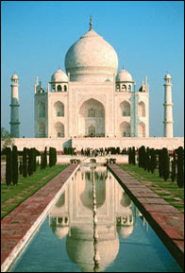
2. Name the type of balance
Llame el tipo de balanza

Slide 11
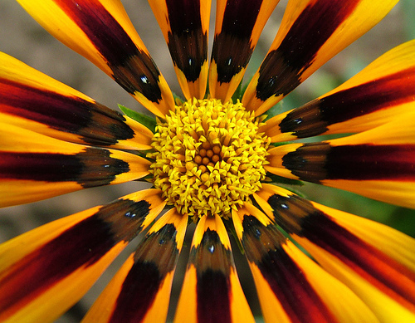
3. Name the type of balance
http://www.artworkbyrachel.com/radial-balance.html

Slide 12
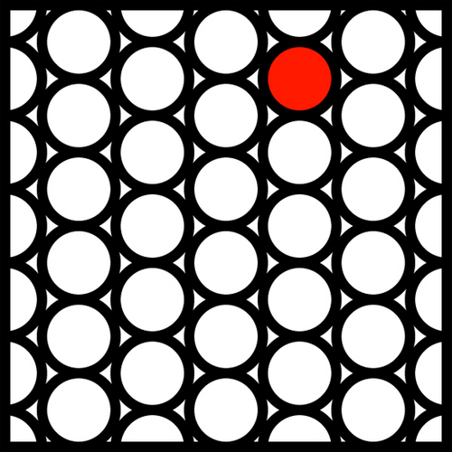
Emphasis
énfasis
The center of interest
The place where your eye goes first
El centro de interés
El lugar donde su ojo se ve al principio
http://jpmdp.weebly.com/digital-arts.html

Slide 13
Contrast a shape with its surroundings
1. Contraste una forma con su etorno
6
T
E
C
H
N
I
Q
U
E
S
2. Create a contrast of temperature
2. Crear una contraste de temperature de color
3. Use a darker or lighter value
3. Utilice un valor más oscuro o más claro
6 técnicas

Slide 14
4. Focus attention with converging lines
4. Centrar atención con líneas convergentes
6
T
E
C
H
N
I
Q
U
E
S
5. Isolate the object you want emphasized
5. Aislar el objeto que quiere enfatizado
6. Increase the object’s intensity of color
6. Aumento la intensidad del color
6 técnicas

Slide 15
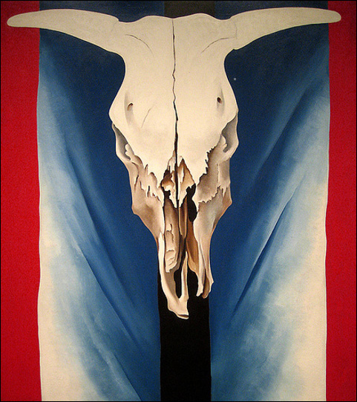
How is this painting balanced?
Where is the emphasis in this painting?
Georgia O’Keefe
Cow’s Skull: Red, White, and Blue.
Painting

