Slide 1
Today’s lesson: Color
We will:
Learn the concept of color and the beginnings of color theory
Explore color schemes
Connect what we know from every day sightings to color theory
You will:
Add color to your graffiti tags using one of the color schemes we learned from color theory

Slide 2
COLOR
Element of Art
Produced when light hits an object and is reflected back to the eye

Slide 3
3 Properties
Draw a box with the color as heavy as possible
Hue: the name we give to a color
Value: the color’s lightness or darkness
Intensity: the strength and vividness of the color
Ex: the color blue can be described as “royal” (rich, vibrant, bright) or “dull” (grayed)
Draw a long rectangle. Color in from lightest to darkest
Draw the long rectangle again and color first with the HUE then add white to one side and gray to the other

Slide 4
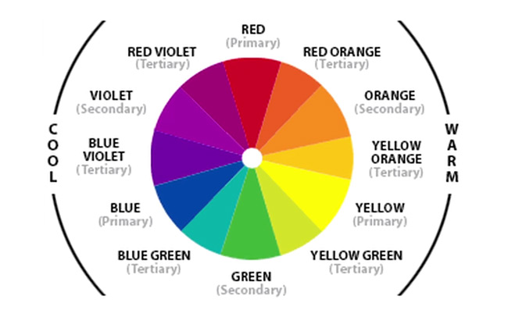
The Color Wheel
http://www.slrlounge.com/introduction-to-color-theory/

Slide 5
Primary : “pure” colors that are not made by mixing other colors
Secondary : made by mixing two primary colors together equally
Tertiary: colors created by 25-75% mix between a primary color and a secondary color
Red Yellow Blue
Orange Green Purple
Blue-Green Yellow-Green Red-Orange

Slide 6
Color schemes
Complementary
Colors across from each other on the color wheel
Analogous
Located next to each other on the color wheel
Clash
Colors that are one space off from being complementary
Monochromatic “mono”= one “chrome”= color
Hue stays the same and only the saturation and brightness change
The Effect of Color | Off Book | PBS Digital Studios
https://www.youtube.com/watch?v=nX0DHd5QNS8#t=323

Slide 7
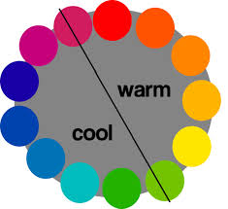
Warm Colors
Seem to come out at you
Cool Colors
Recede into space
Neutral Colors
http://painting-course.com/296/color-theory/warm-and-cool-colors/

Slide 8
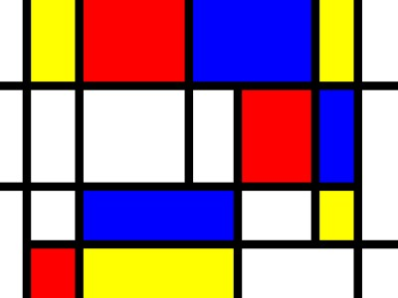
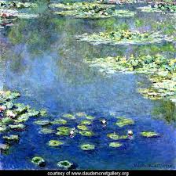
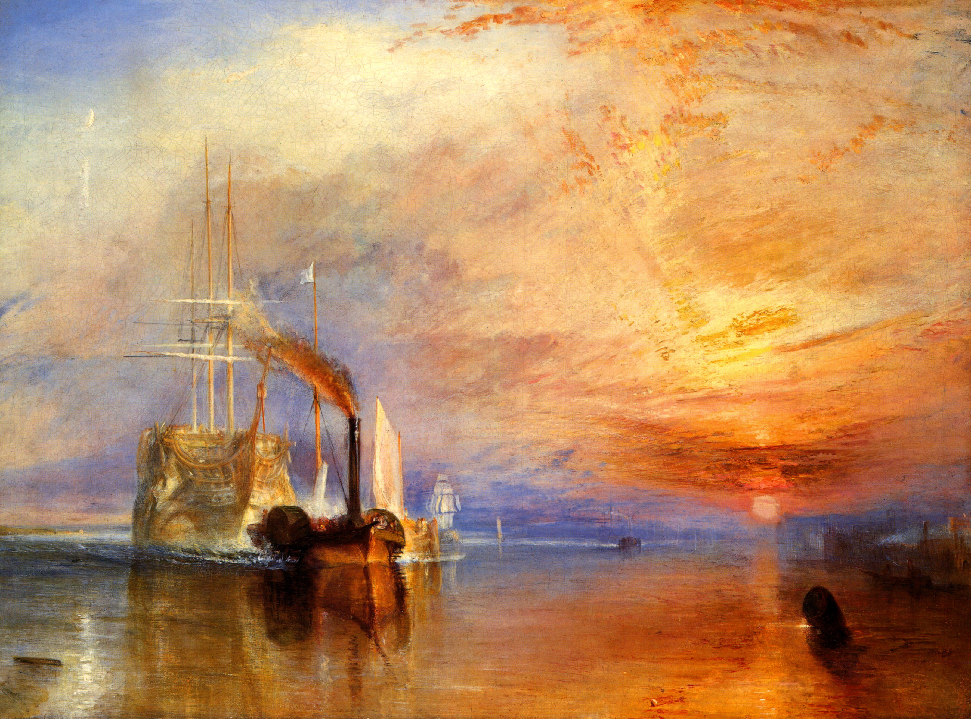
Claude
Monet
Piet Mondrian
William Turner

Slide 9
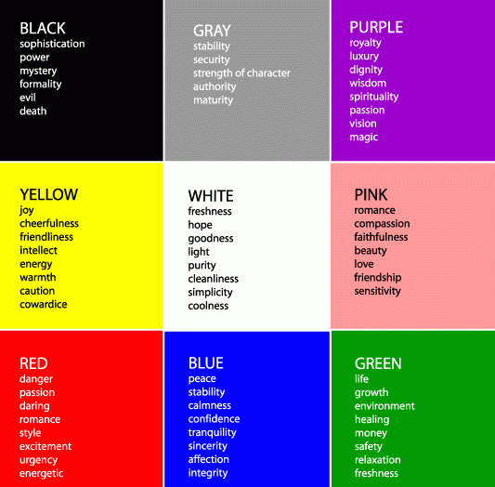
http://www.interiordesignipedia.com/color-meanings.html

Slide 10
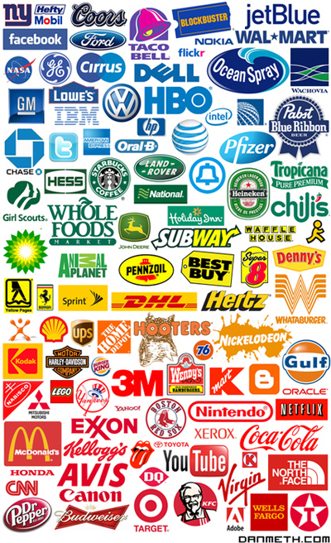
Pick one or two logos and explain why you think that company used their colors.
Example: I think Whataburger uses orange and white in their logo because white signifies goodness or freshness and orange is a cross between red and yellow meaning it is joyful and hunger-inducing.
I think______ uses their colors _____ and _____ in their logo because ______________.
http://themgroupcreative.com/logo-design-colors-guide-consumers/

