Slide 1
Please retrieve your portfolios, and have your signatures out
Today we will,
Explore the principle of design called Proportion
Take notes and drawings in our artist journals
Connect what we see everyday to our studies in proportion
Today I will,
Answer a question concerning proportion and the Golden Ratio
Connect Proportion to a previously learned Principle of Design
Be able to draw a face and body proportionally …(loosely)

Slide 2
Proportion
Principle of Design
refers to the size relationship of
certain elements to the whole of the picture and to each other
La Proporción
Principio de diseño
Se refiere a las relaciones del tamaño de los elementos de la totalidad de la imagen y a otros elementos

Slide 3
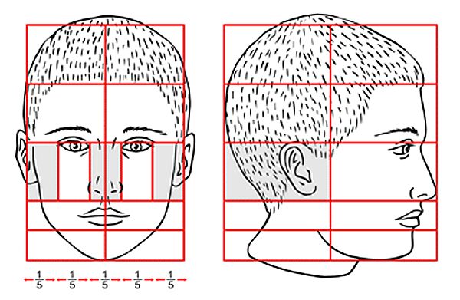
Proportion really just means you are making the parts fit well together
Like the parts of a face
Proporción realmente significa que está haciendo las piezas encajan bien.

Slide 4
The Golden Ratio or Divine Proportion
Discovered by the ancient Greeks
defined by the number
Phi (Φ = 1.618)
Ratio of 1: 1.618
divides anything at “just the right point” between 1/3 and 1/2 the distance from one end
It is considered the most visually pleasing division.
Proporción de oro
Razón de 1: 1.618
Se divide en el punto correcto
La mayoría visulamente por favor división

Slide 5
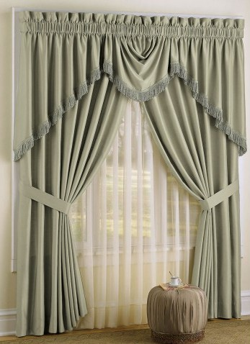
The golden ratio is the division of a line anyplace between 1/2 and 1/3 of its total length.
The curtains to the right are tied back at the golden ratio for this window.
1/3
1/2
1/3
Las cortinas de la derecha están vinculados a la proporción de oro.

Slide 6
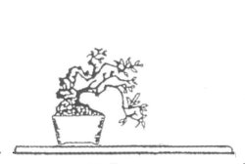
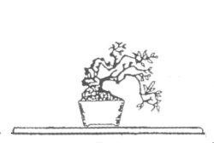
Write about it… The designer wants to place this plant on a shelf. According to the golden ratio, which placement is more pleasing to the eye?...
?Qué la colocación es más agradable a la vista, utilizando las porporción de oro?
Placing the plant slightly to the left of the center?
Placing the plant directly in the center of the shelf?
OR
I think the shelf with the plant (in the center/on the side) is more pleasing to the eye because ________________________.
Answer: I think the shelf with the plant on the side is more pleasing to the eye because the asymmetry of the golden ratio is usually more pleasing to the eye.

Slide 7
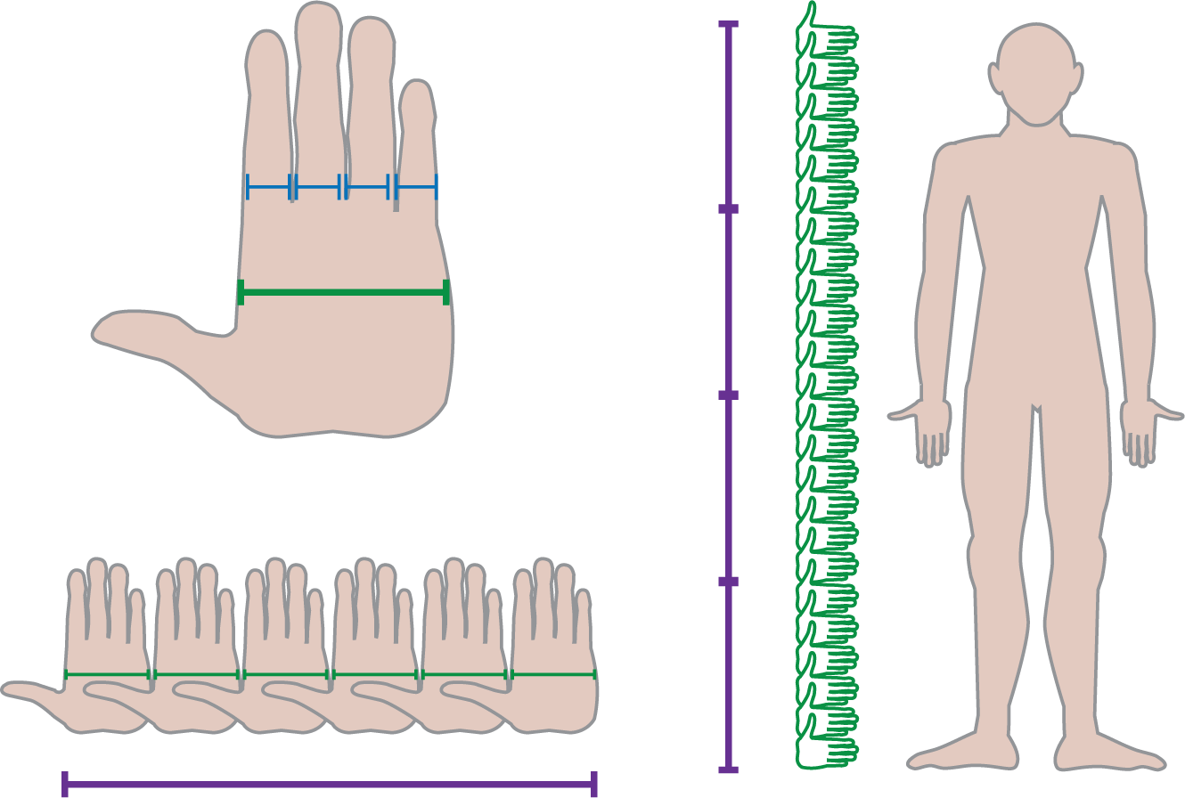
Ways to Measure Proportion
Carefully chosen proportion can make an art object seem pleasing to the eye, but we should have a way to measure the proportions.
The ancient Egyptians used the palm of the hand as a unit of measurement
Los egipcios antiguos utilizan la palma de la mano como una unidad de medida.
The ancient Greeks sought an ideal of beauty in the principle of proportion
Griegos antiguos buscaron la belleza a traves de las proporciones del cuerpo humano.
Cuidadosamente seleccionados proporción puede hacer que un objeto de arte parece agradable a la vista, pero debemos tener una manera de medir las proporciones.
Notes:
The models used by the Greeks for calculating human proportion were later adopted by artists of ancient Rome, and then by Renaissance artists

Slide 8
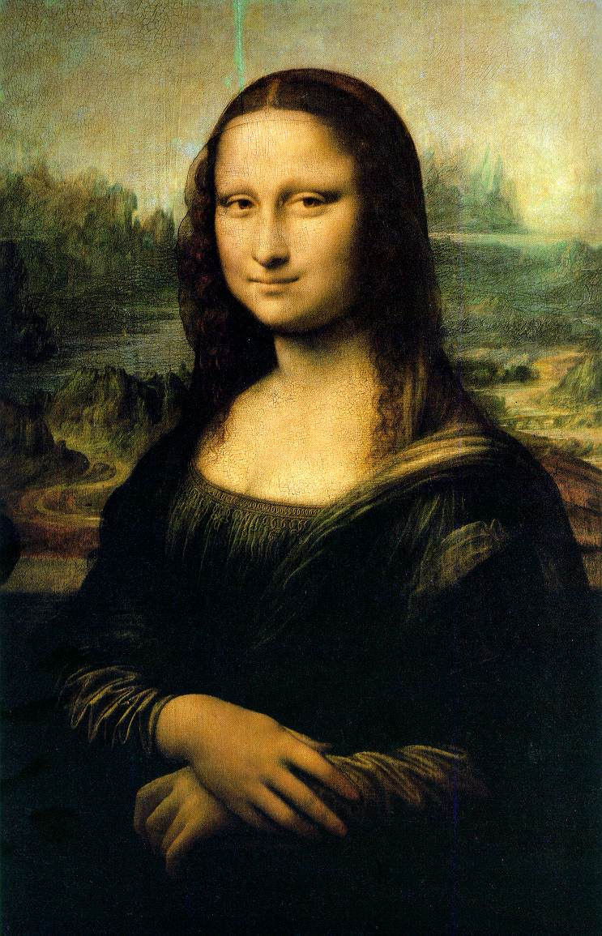
Leonardo Da Vinci
Do you know this painting?
This is one of the most famous paintings in the world…
Leonardo once wrote, “Know the proportions in human beings and other animals and learn the forms of all things on the earth. The more you know, the better you will paint.”
Este cuadro famosa fue realizado por Leonardo Da Vinci. Leonardo escribió, “Conocer las proporciones en los seres humanos y las formas de todas las cosas en la tierra. Más sabe, mejor pintará.”

Slide 9
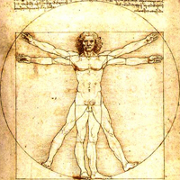
Leonardo was constantly taking notes about the world around him. He filled many notebooks with sketches of animals, people, and nature.
Da Vinci constantemente tomaba notas sobre el mundo que le rodea. Llenó muchos cuadernos de bocetos de animales, personas, y naturaleza.
He took many measurements and was always trying to find a perfect balance so that his art had proportion.
Tomaron muchas medidas y siempre estaba tratando de encontrar un equilibrio perfecto para que su arte tenía proporción.
This was taken from his art journal
Esto fue tomando de la revista de arte.

Slide 10
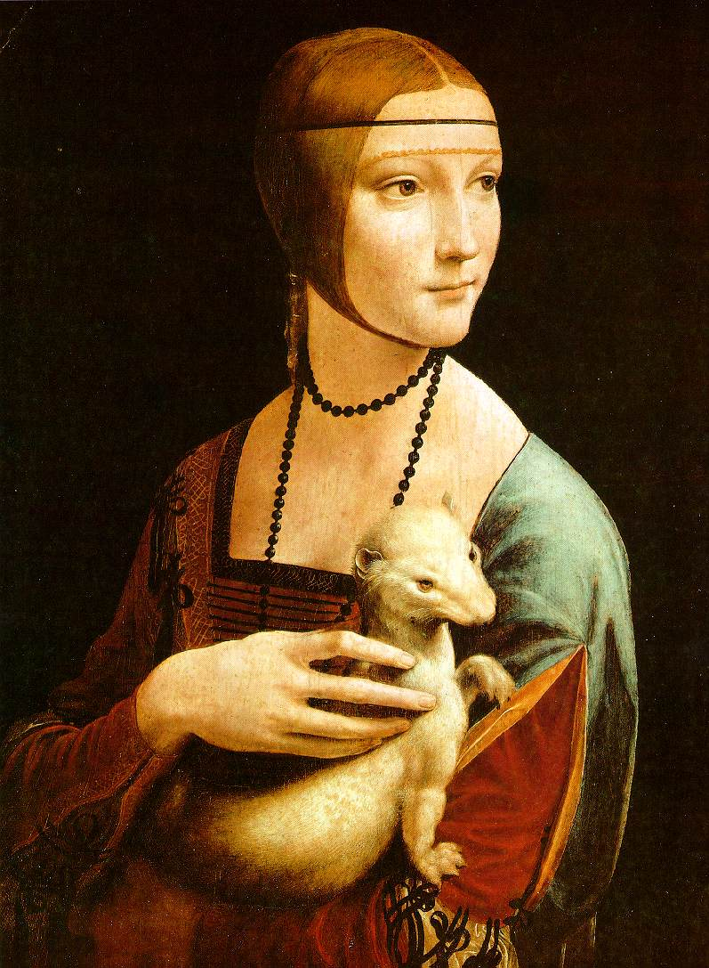
When the face is looking to the side like that, we call it “3/4 View”
This is a perfectly proportional painting
Cuando el cuerpo y/o la cabeza se enfrenta a la esquina o lateral, lo llamamos una vista ¾.
Este es una pintura perfectamente proporcional.

Slide 11
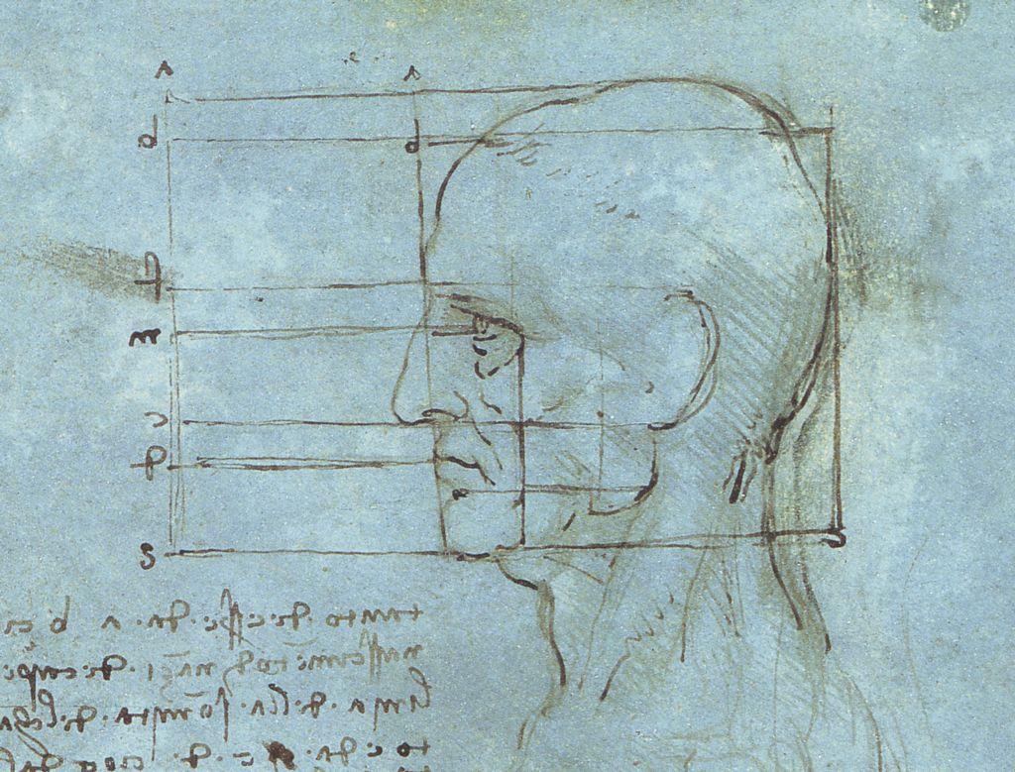
This is another sketch found in Da Vinci’s journal…
Otro dibujo encontrado en diario de Da Vinci.

Slide 12
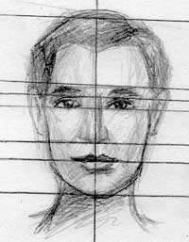
Facial Mapping
Facial mapping is a technique used to set up the proportions of the features on a face
Mapeo facial: una técnica que se utiliza para configurar lascaracterísticas de una cara
By setting up guidelines that act as roads, you can figure out where parts go and how large they should be.
A establecer las directrices, usted puede entender cómo la partes van y qué grande deberían ser.

Slide 13
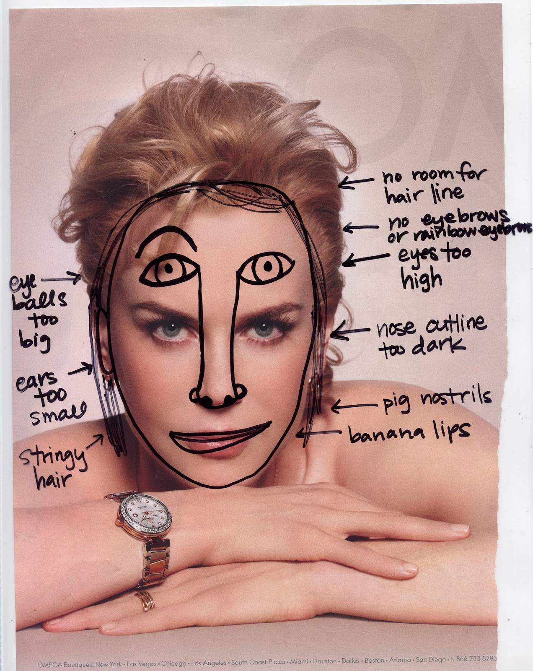
And if you don’t use facial mapping, you’ll get this… ←
Y si no se utiliza el mapeo facial, esto es lo que obtendrá…

Slide 14
For the rest of class…
Finish assembling your Zentangle project
Cut your outline out of your white Zentangled paper, then glue each piece to a black piece of paper
Pick up the 4 handouts on proportion and work in your artist journal
We will be working with proportion for our next project, so work hard to understand facial mapping and the proportions

