Slide 1
Pattern and Repetition
2 Separate Principles of Design
Take note of everything in BLUE

Slide 2
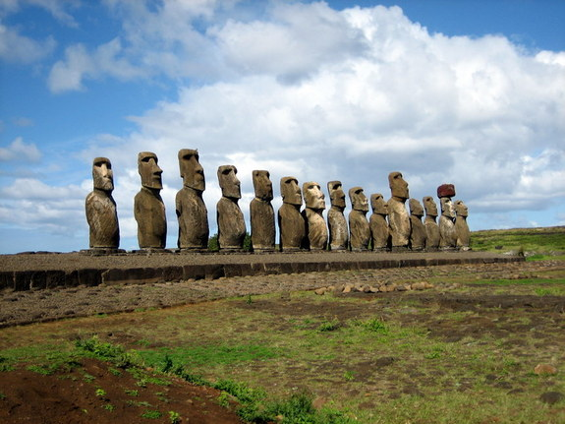
Repetition
One object or shape repeated
Easter Island, Ahu Tongariki, repetition as intimidation
http://www.sophia.org/tutorials/design-in-art-repetition-pattern-and-rhythm

Slide 3
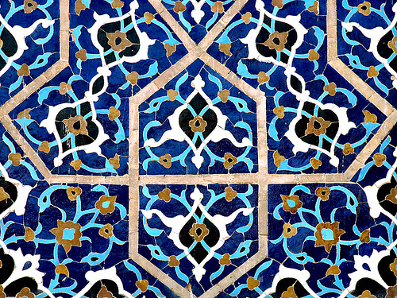
Pattern
The repetition or reoccurrence of a design element
Establishes a visual beat
Repetition of lines, shapes, colors, textures—what do we call all of those?
http://www.djibnet.com/photo/ceramic+patterns/isfahan-jame-mosque-tile-works-151771998.html

Slide 4
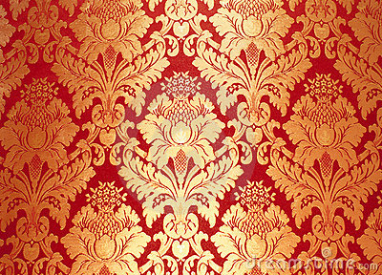
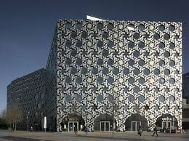
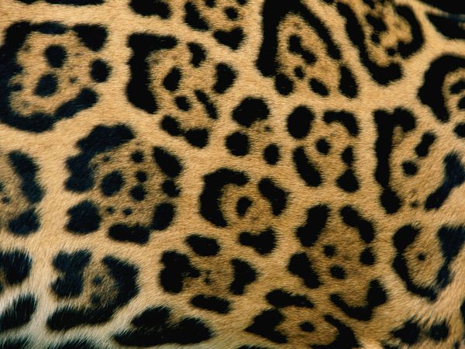
Pattern is everywhere! In clothes, buildings, carpets, animals, trees, and manufactured things
Patterns are made in art when the same shapes or elements are repeated again and again
Pattern makes art more exciting by decorating the surfaces of paintings, sculptures, crafts, or architecture

Slide 5
Natural patterns
Patterns surround us in nature- leaf patterns, flowers, shells
The radial pattern in many fruits and vegetables can be seen when they are cut in half

Slide 6
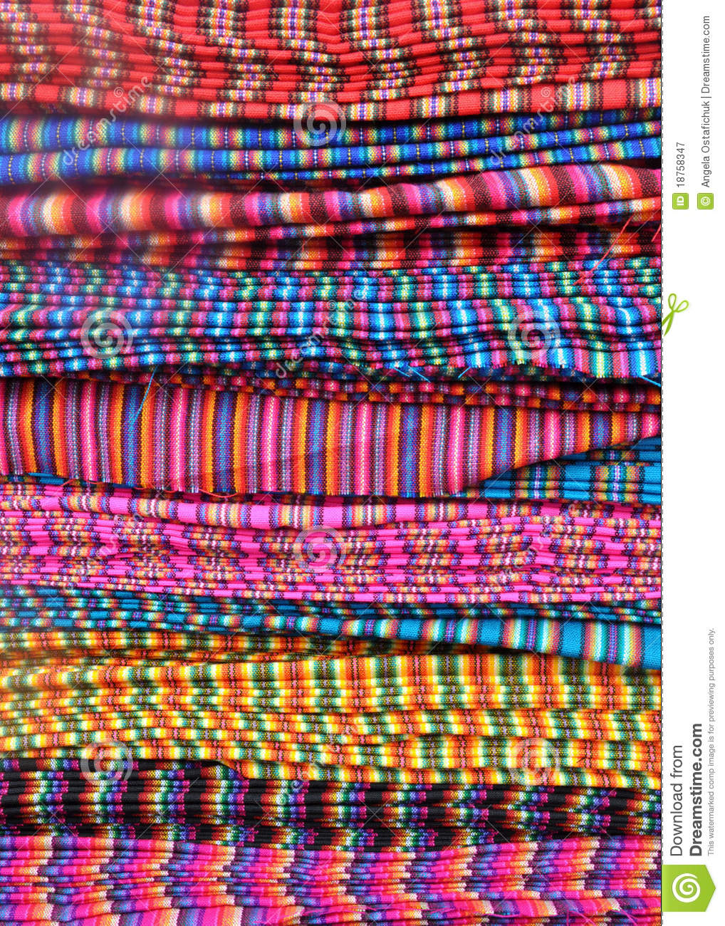
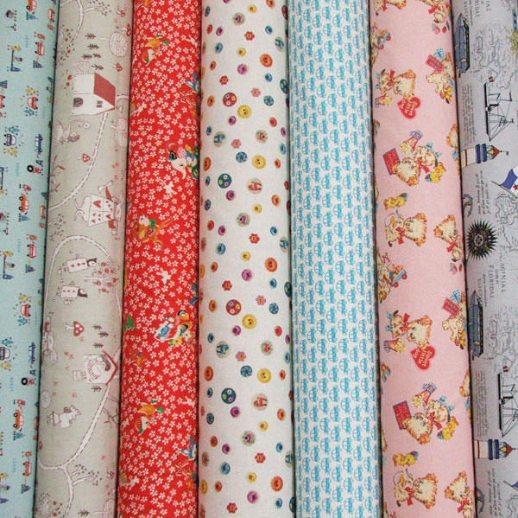
Fabric Patterns
The fabrics in many of the clothes we wear are patterned
They may contain repetitions of shapes, lines, and colors

Slide 7
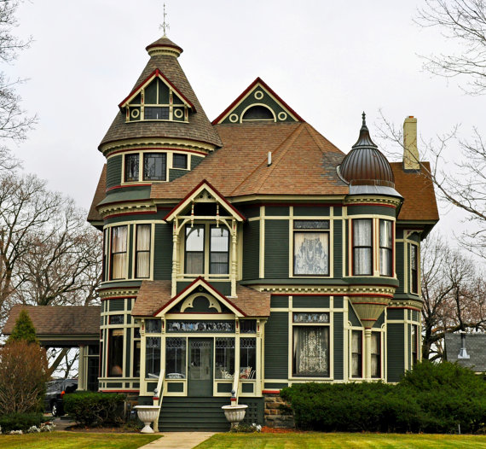
Pattern in Architecture
The surface of a Victorian Style house is interesting because of the many colors and patterns- on the roof, shingles, siding, boards, and trim above windows
https://www.etsy.com/listing/166904518/cross-stitch-pattern-victorian-house

Slide 8
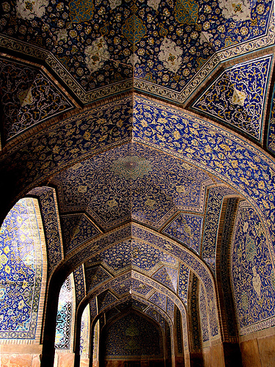
Islamic patterns
Islamic spiritual art does not allow imagery, so pattern is used to convey spiritual principles.
This is a picture of a mosque in Isfahan, and below is a close-up of the tiles.
http://www.djibnet.com/photo/ceramic+patterns/isfahan-imam-shah-mosque-154089152.html

Slide 9
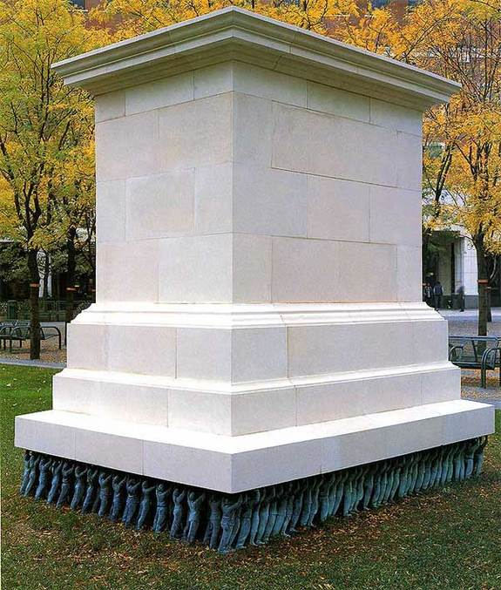
Do-Ho Suh. Public Figures, 2001. Stone and bronze
What do you think of Do-Ho Suh’s message?
How does this affect what you think of traditional monuments?
Do-Ho Suh convierte el tradicional monumento boca abajo, de modo que en lugar de una sola figura se alza sobre un pedestal, el pedestal es apoyado por muchas figuras masculinas y femeninas. ¿Qué piensa usted de su mensaje?
¿Cómo afecta esto a lo que piensas de monumentos tradicionales.
http://legacy.earlham.edu/~vanbma/20th%20century/images/1967daytwentyeight08.htm
Notes:
Do-Ho Suh turns the traditional monument upside down, so that instead of a single figure being perched on a pedestal, the pedestal is supported by many male and female figures.

Slide 10
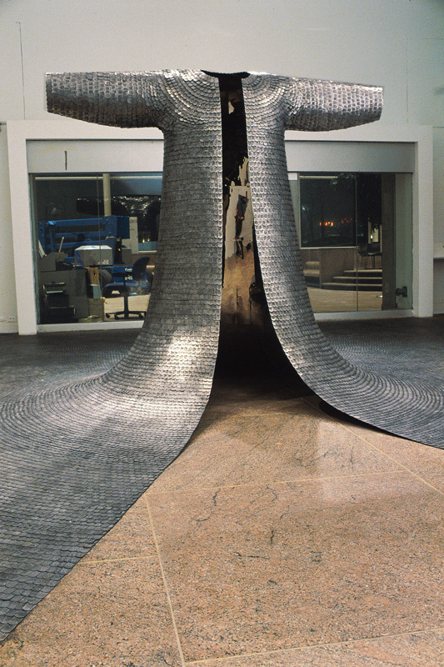
Do-Ho-Suh
In this sculpture, each figure is different from the others, although they appear as a single entity. As a group, they carry the weight of history and the actions of every person, great or small.
En esta escultura, cada figura es diferente de los demás, aunque aparecen como una sola entidad. Como grupo, llevan el peso de la historia y las acciones de cada persona, grandes o pequeñas.
Do-Ho-Suh uses repetition in much of his work as a profound statement about the value of each individual within a larger group.

