Slide 1
Please retrieve your portfolios and have your signatures ready
Today we will,
Explore the principles of Rhythm and Movement as they apply to art
Create gestural drawings of bodies
Experiment with oil pastels
Today, I will:
Respond to questions regarding movement and rhythm as they pertain to art
Complete 5 gestural drawings
Please take note of everything that is in BLUE

Slide 2
Rhythm
Principle of Design
A combination of repeated elements with variations or changes.
Like a dance, it will have a flow of objects that will seem to be like the beat of music.
El Ritmo
Principio de diseño Una combinación de elementos repetidos con variaciones o cambios. Como un baile, tendrá un flujo de objetos que se parecen ser como el ritmo de la música.

Slide 4
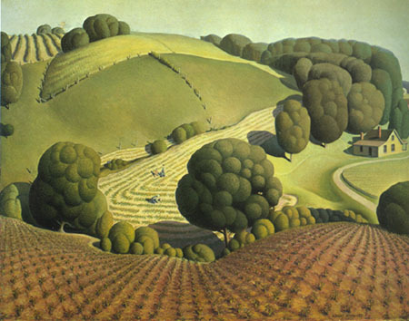
Grant Wood
Young corn, 1931.
Rolling plains and field of the Midwest

Slide 5
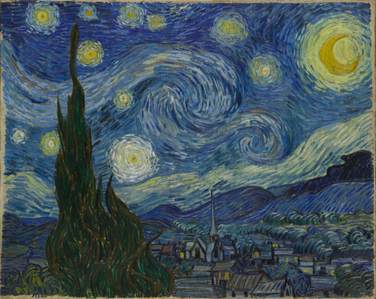
Vincent Van Gogh. The Starry Night, 1889. Oil paint on canvas, 29x36 inches.

Slide 6
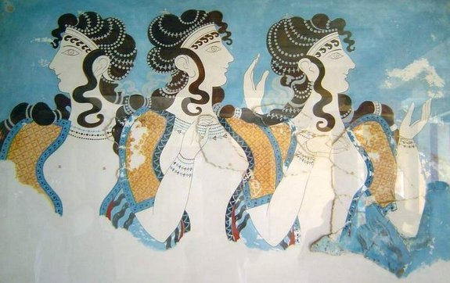
Three women, fresco from Knossos palace, island of Crete Minoan civilization (27th -15th c. BCE)
The Minoan civilization was long and peaceful. The palace at Knossos was large, colorful, and advanced in its engineering. The walls were covered with frescoes of humans and animals in a vibrant enjoyable world.
In this fresco, notice the varied repetition of the figures, the hair, hands. and clothes. The graceful variations in these elements impart a graceful rhythm to the fresco.

Slide 7
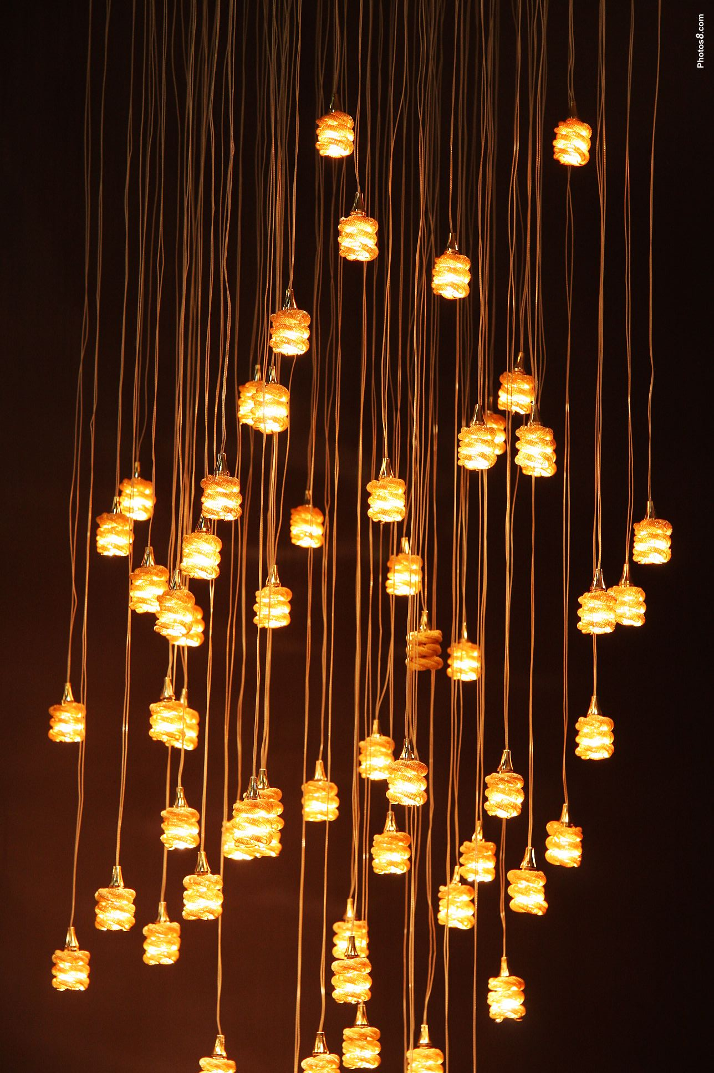
Movement Principle of Design
Do your eyes jump around when you look at this photo?
Your eye moves around this piece because the lights are spaced out in a rhythmic way just like notes are placed on a sheet of music. The contrast of the light and the dark background make the lights and lines stick out.
The suggestion of motion through the use of various elements
The path the viewer’s eye takes through an artwork, directed by lines, edges, shapes, and color
El movimiento
La sugerencia de movimiento mediante el uso de varios elementos El camino lleva a ojo del espectador a través de una obra de arte, dirigida por los bordes, líneas, formas y color
https://sites.google.com/site/principlesofdesignsite/home/rhythm-movement

Slide 8
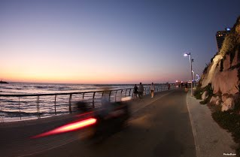
https://sites.google.com/site/principlesofdesignsite/home/rhythm-movement
W
R
I
T
E
A
B
O
U
T
I
T
How is this photograph showing movement?
What elements of art are being used?
¿Cómo es esta fotografía mostrando movimiento? ¿Qué elementos de arte se utilizan?
This photo shows movement because ________.
It uses these elements of art: _______________

