Slide 1
Space
Element of Art
The area between and around objects

Slide 2
Today :
We will:
I will:
Explore the element of Space as a fundamental of art
Identify positive and negative spaces in images
Always: Use our note-taking skills to continue our artist journal’s vocabulary of the day
Use my knowledge of the elements and Zentangle to create a unified and complete Zentangle drawing

Slide 3
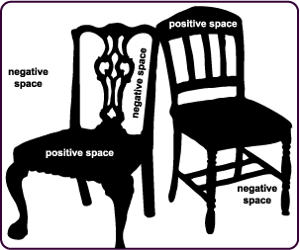
Positive & Negative
The space around objects
The areas that are the subject or object itself
http://www.artsconnected.org/toolkit/encyc_shapeposneg.html

Slide 4
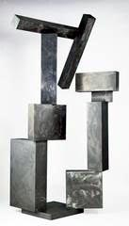
David Smith
Cubi IX
1961
stainless steel
The negative shape inside this sculpture repeats the overall structure of the sculptor’s positive shapes.
The geometry of the boxes piled high emphasizes gravity.
The negative shape in the middle of the sculpture gives it a light, playful appearance.
http://www.artsconnected.org/toolkit/encyc_shapeposneg.html

Slide 5
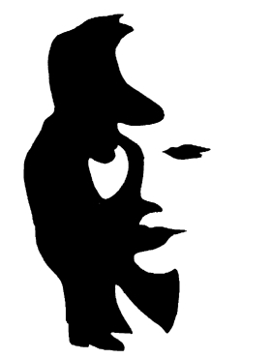
What do you see?
Let your eyes adjust a couple times.
There are two images.
Describe both, then identify the positive and negative space in each one.
Ex: Positive space = white
Negative space= black
http://www.artsconnected.org/toolkit/encyc_shapeposneg.html

Slide 6
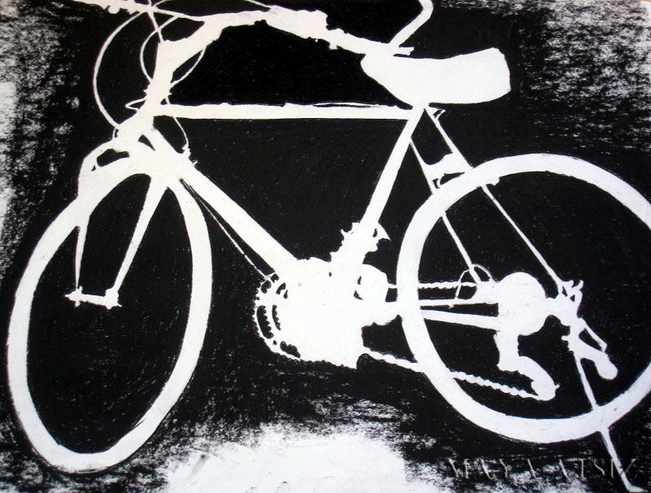
http://1yearsjourney.blogspot.com/

Slide 7
http://mrsdahl.wordpress.com/tag/positive-negative-space/

Slide 8
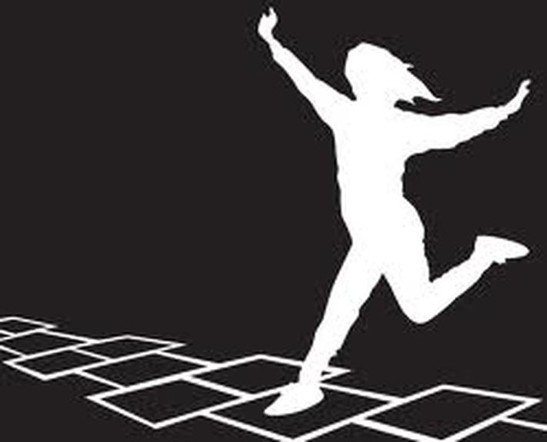
http://reiner124.weebly.com/5th-grade-3-positive--negative-space.html

Slide 9
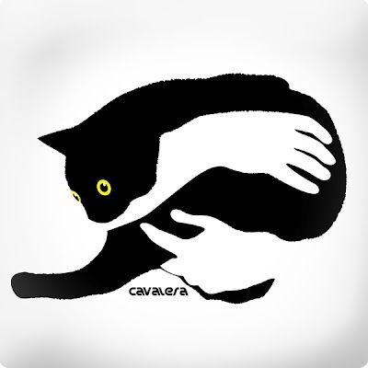
http://welovecatsandkittens.com/cat-pictures/cats-nose-are-too-cute-right-5th-july-2013/

Slide 10
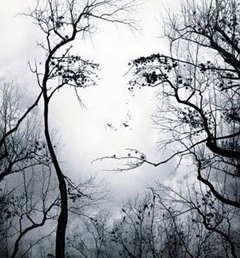
http://images.search.yahoo.com/images/view;_ylt=A0PDoS4BrAhPl0oAl0qJzbkF;_ylu=X3oDMTBlMTQ4cGxyBHNlYwNzcgRzbGsDaW1n?back=http://images.search.yahoo.com/search/images%3F_adv_prop%3Dimage%26va%3Damazing%2Btree%26fr%3Datt-portal%26tab%3Dorganic%26ri%3D11&w=297&h=320&imgurl=4.bp.blogspot.com/_xm56s1x5xzU/Sv1A2ayrhtI/AAAAAAAACO4/CNlemtWX-cI/s320/face-in-trees-illusion.jpg&rurl=http://imagedownloads.blogspot.com/2009/11/amazing-tree-wallpaper-nature-picture.html&size=42.4+KB&name=Amazing+Tree+Wallpaper,+Download+Nature+Wallpapers&p=amazing+tree&oid=3227f1ed2644e8e67bc293d14e537797&fr2=&fr=att-portal&tt=Amazing%2BTree%2BWallpaper%252C%2BDownload%2BNature%2BWallpapers&b=0&ni=21&no=11&tab=organic&ts=&sigr=12l501hp4&sigb=13cu00ll2&sigi=132e4hgfv&.crumb=.auNSt7aTk6

Slide 11
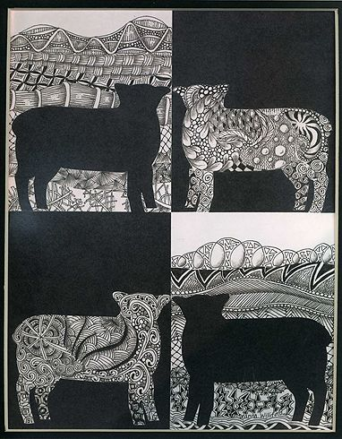
We will be drawing Zentangles then using our knowledge of positive and negative space to create an interesting artwork.
Your subject will be your hand, and you will be using black pens and Sharpies.
http://archive.constantcontact.com/fs023/1101168872594/archive/1109823754220.html

Slide 13
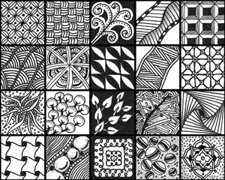
Zentangles
Unplanned- the results will surprise you
Can be viewed and drawn from any direction
Abstract, non-representative art
A collection of patterns
NOT doodling– there is a foundation and process

