Slide 1
Texture
Element of Art
Refers to how things feel or look how they might feel if touched

Slide 2
Texture is perceived by touch and sight
Tactile Texture:
how an object actually feels in real life
Ex: Artist Vincent van Gogh would add sand to his oil paints to create tactile texture
Visual Texture:
how an object appears it will feel; the illusion of a surface’s texture
Ex: No matter how rough objects look in a photograph, the surface of the photo is always smooth

Slide 3
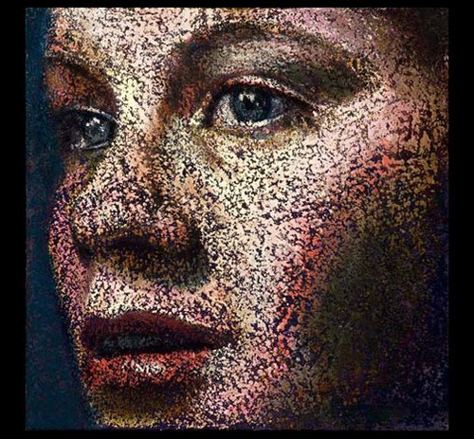
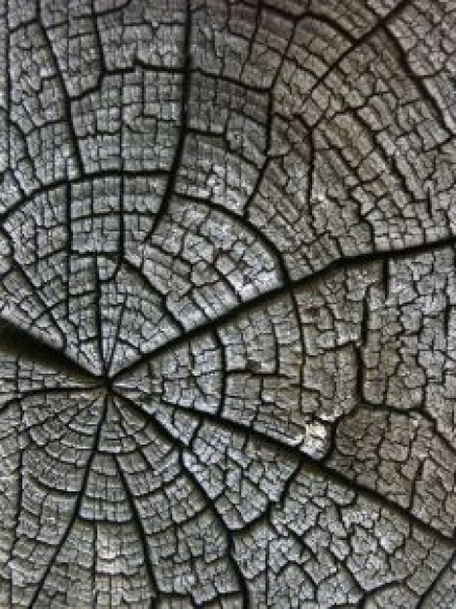
Tactile or Visual Texture?

Slide 5
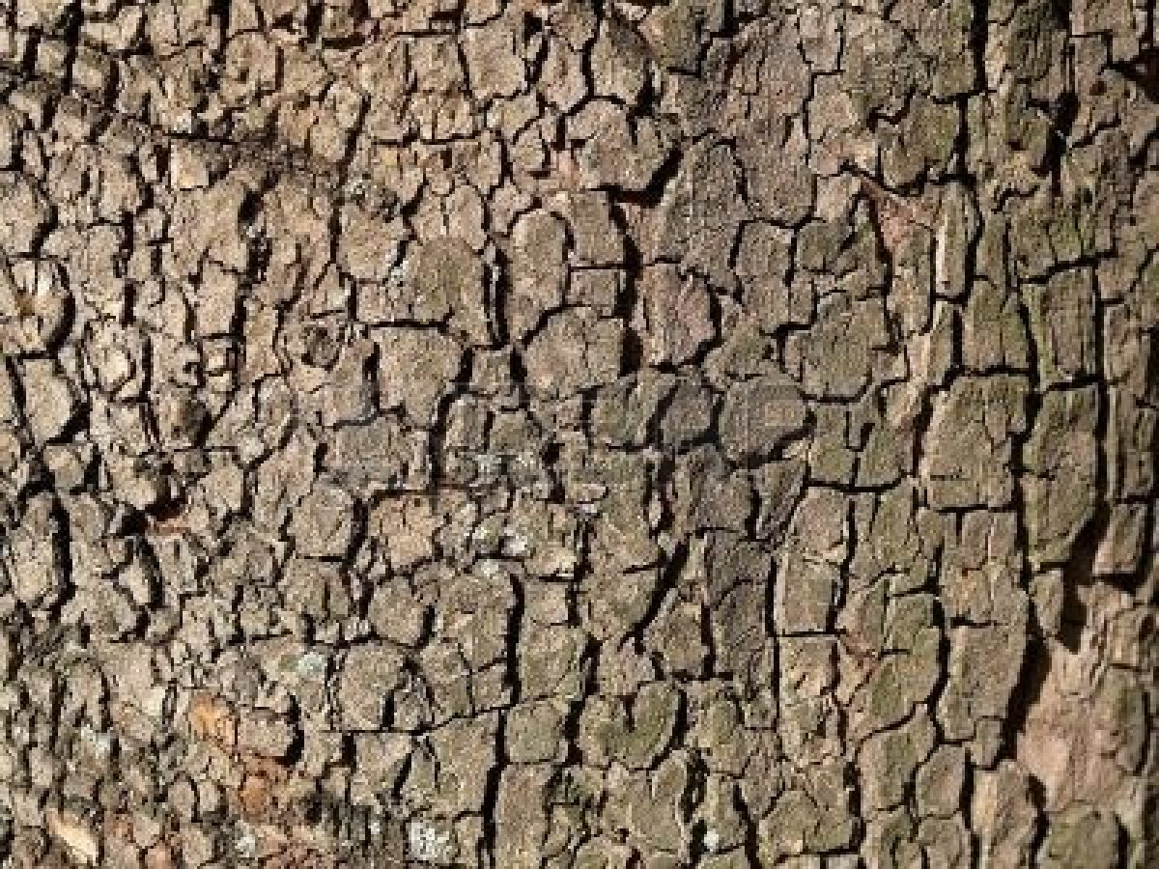
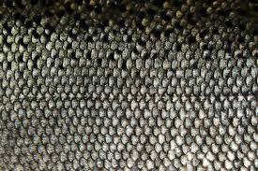
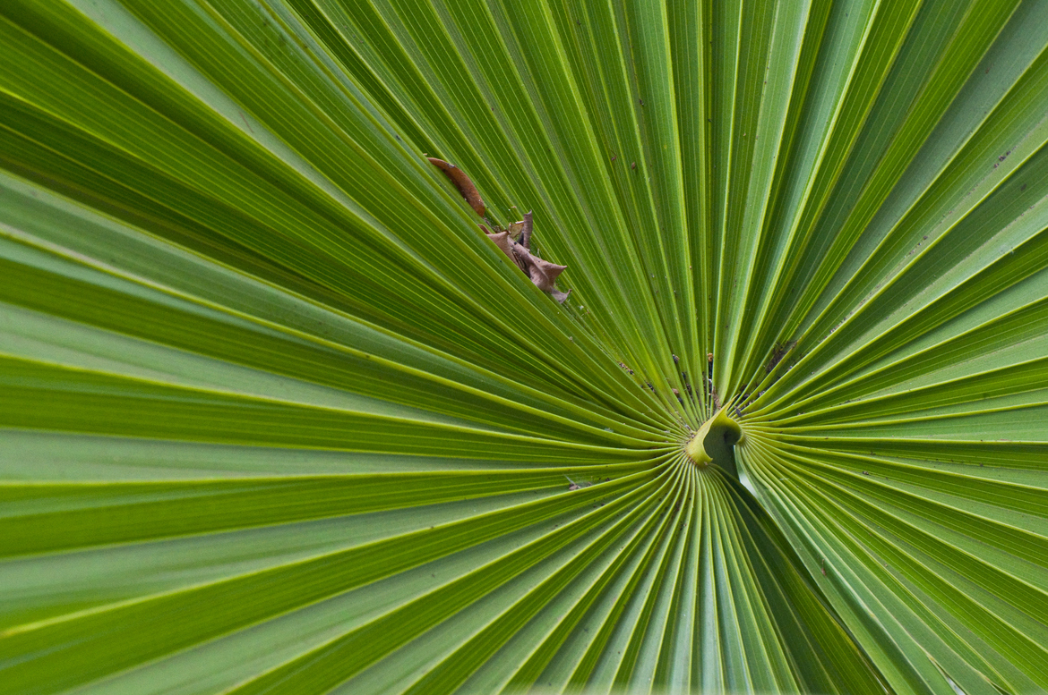
Natural Textures

Slide 6
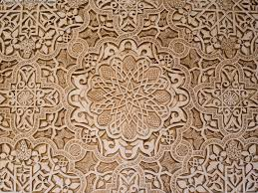
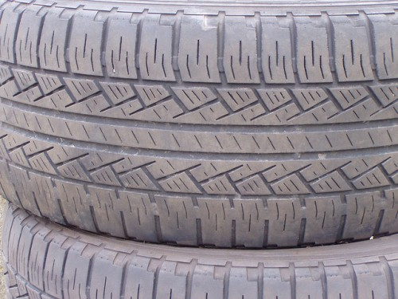
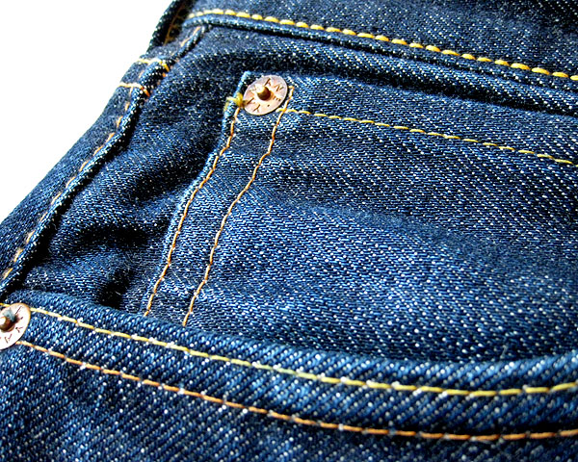
Artificial Texture
A texture that is manmade

Slide 7
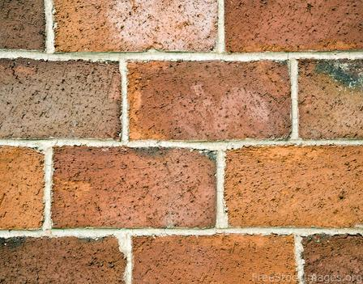
Tactile or Visual Texture?

Slide 8
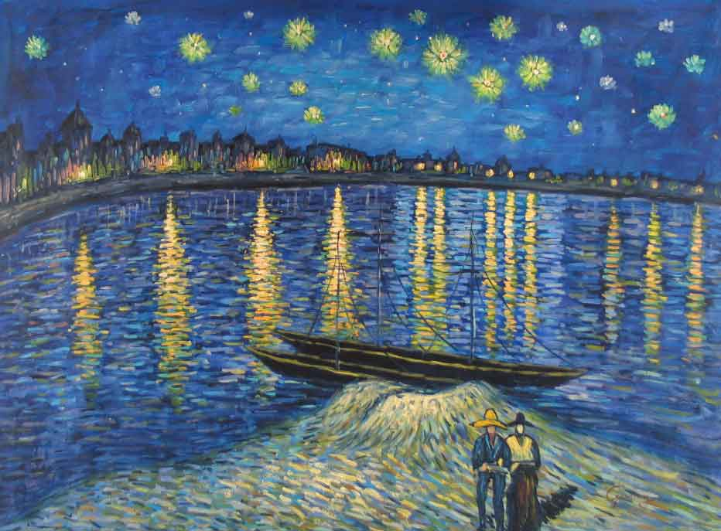
Write about it…
Is this a tactile or visual texture?
Write about what the texture does to the painting/how it changes it.
Vincent Van Gogh
“Starry Night Over the Rhone”
1888
2.5x 3 feet
Oil paint on canvas

