Slide 1
Unity and Variety
Principles of Design
Unity in an artwork creates a sense of harmony and wholeness by using similar elements within the composition and placing them in a way that brings them all together.
Variety adds interest by using contrasting elements within the composition.
La Unidad y la Variedad
Unidad crea un sentido de armonia.
Variedad añade interés por utilizar elementos contrastantes.

Slide 2
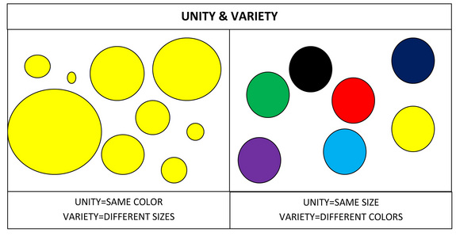
Unidad = mismo color
Variedad = tamanos diferentes
Unidad = mismo tamanos
Variedad = colores diferentes

Slide 3
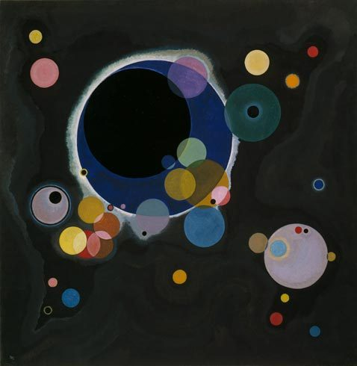
Write about it…
How is he creating unity?
How is he creating variety?
¿Cómo está creando la unidad?
¿Cómo está creando gran variedad?
Wasily Kandinsky.
Several Circles (Einige Kreise), January–February 1926.
Oil on canvas, 55 x 55 inches
http://www.sophia.org/tutorials/design-in-art-emphasis-variety-and-unity
Notes:
Kandinsky was a pioneer in the development of abstract, nonrepresentational art. He believed in the expressive qualities of abstract forms and the possibilities of a universal visual language through those forms. For him, each color and shape had its own symbolic significance and properties.
In this composition, unity is provided by the repetition of circles on a neutral background. Variety is added by varying the sizes and colors of the circles, and by overlapping them.

Slide 4
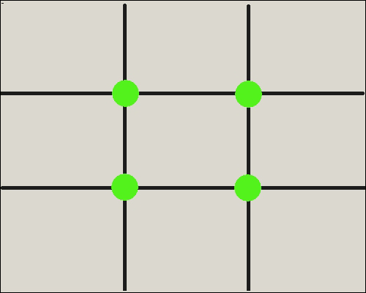
Rule of Thirds La regla de los tercios
Divide a canvas up into thirds both horizontally and vertically
Place the focus of the work where the lines intersect--either 1/3 across or 1/3 up or down a picture
Dividir un lienzo en tercios tanto horizontal como verticalmente
Colocar el foco de la imagen donde se intersectan las lÍneas

Slide 5
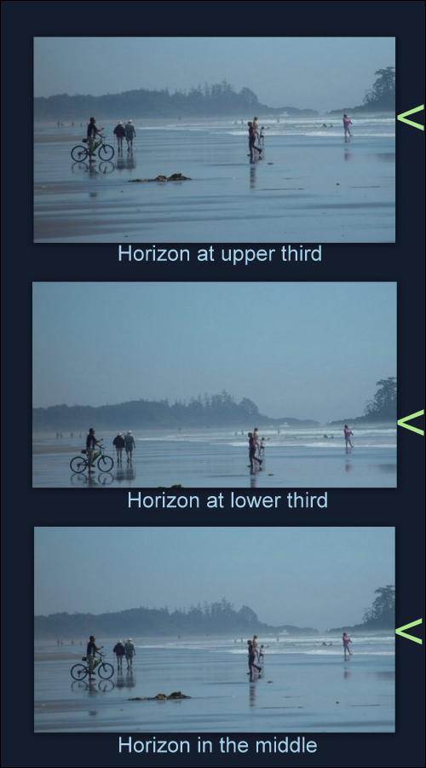
The Horizon Line
La Línea del Horizonte
Avoid placing anything in the exact center, including horizon lines
Placing the horizon line at the top 1/3 or bottom 1/3 of an image creates a more attractive composition
Evite colocar nada en el centro, incluyendo la linea del horizonte.
http://emptyeasel.com/2009/02/03/the-rule-of-thirds-why-it-works-and-how-to-use-it-in-your-art/

Slide 6
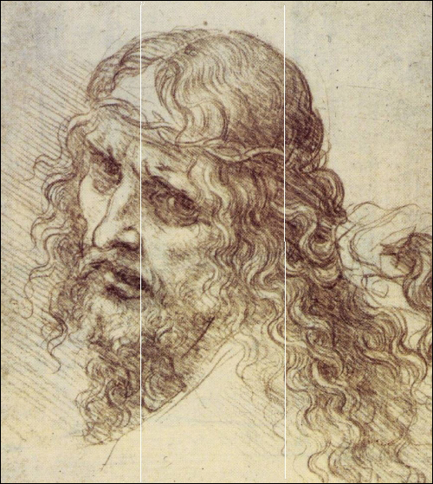
Even though the face is placed daringly close to the left edge, those eyes pointing back toward the center keep our attention from leaving the image.
Then by drawing the head tilted toward the right third and the hair flowing off toward the right bottom corner, Leonardo created a stunningly balanced yet dynamic and emotional image.
http://emptyeasel.com/2009/02/03/the-rule-of-thirds-why-it-works-and-how-to-use-it-in-your-art/

Slide 7
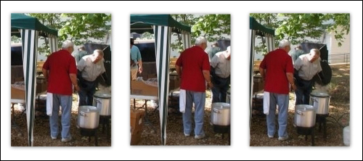
http://emptyeasel.com/2009/02/03/the-rule-of-thirds-why-it-works-and-how-to-use-it-in-your-art/
Write about it….
Which photograph do you think is the most successful, concerning the Rule of Thirds?
?Qué foto es el que tiene más éxito a usando la regla de los tercios?

Slide 8
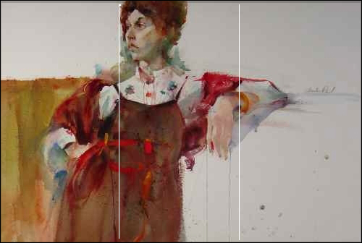
http://emptyeasel.com/2009/02/03/the-rule-of-thirds-why-it-works-and-how-to-use-it-in-your-art/

