Slide 1
Today…
Please retrieve your portfolios and have your signature on your desk.
Bring syllabus, contract, and parent info sheets to my desk.
We will:
Explore value as an element of art
Create value scales in our artist journals
Continue working on our Zentangle designs
I will:
Complete 3 value scales
Respond to an Ansel Adams photograph

Slide 2
VALUE
Element of Art
Refers to the lightness or darkness of a color
El Valor: Elemento de Arte
Se refiere a la luminosidad o la oscuridad de un color

Slide 3
Value scale: A tool used to measure value
Escala de valor: un instrumento para medir el valor

Slide 4
Tint: any color with white added
El Tinte: cualquier color con blanco añadido
Notes:
Lighter values on a value scale are called tints. To make tints, you take the hue and add white.

Slide 5
Shade: any color with black added
Sombra: cualquier color con negro añadido
Notes:
Darker values are called shades. Shades are mixed by adding black to the hue.

Slide 6
Tints make up the highlights in an artwork
Tintes son los toques de luz de una obra de arte.
Notes:
Highlights are typically indicated by the tints of a color.

Slide 7
Shade makes up the shadows in an artwork
Sombra hace que las sombras de una obra de arte.
Notes:
Shadows are typically indicated by the shades of a color.

Slide 8
Creating a full range of value leads to the
illusion of form.
Crear una gama completa de valor lleva a la ilusión de la forma.
Since drawing and painting representationally is about creating the illusion of what we see, creating the illusion of light is important.
Notes:
Since drawing and painting representationally is about creating the illusion of what we see creating the illusion of light is important.

Slide 9
The arrangement of values in a drawing leads to the illusion of a light source, such as a light bulb or flame.
El arreglo de los valores en un dibujo conduce a la ilusión de una fuente de luz como una bombilla de luz o llama.

Slide 10
A full range of value positioned correctly can lead to the illusion of form and light.

Slide 11
Now, attempt a couple sphere illusions….

Slide 12
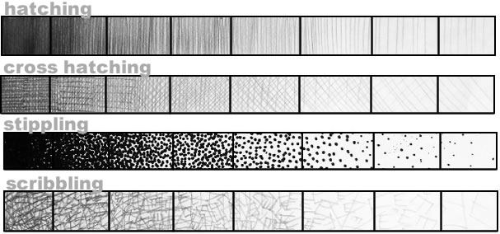
Value does not have to be made with perfect shading with your pencil. You can use these techniques as well.
Valor no tiene que hacerse con sombreado perfecto con el lápiz. Puede utilizar estas técnicas también

Slide 13
Draw a circle
Draw a smaller circle LIGHTLY inside the larger one to signify the highlight
Begin shading from the edges of the large circle and get lighter and lighter as you get towards the highlight
Use your finger to rub and blend the graphite (pencil marks)
http://www.youtube.com/watch?v=KRwCuhqBQz8

Slide 14
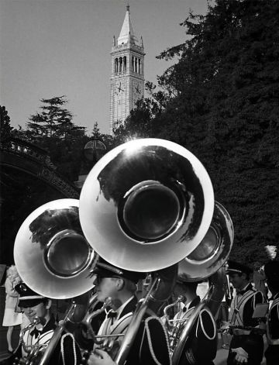
Write about it…
Tell me what you see.
What kind of feeling do you get while looking at this. Stare at it until you can describe some emotional response.
How would you describe the value in this photograph?
Dime lo que ves. ¿Qué clase de sentimiento sacas mirando esto? Mirarlo hasta que se puede describir una respuesta emocional. ¿Cómo describiría el valor de esta fotografía?
Ansel Adams, Untitled, 1968 at UC Berkeley, photograph

